Slide 1
Week 4: Planning for Contingencies

Slide 2
Fundamentals of Contingency Planning
Contingency planning (CP)
The overall planning for unexpected events
Involves preparing for, detecting, reacting to, and recovering from events that threaten the security of information resources and assets
Main goal
The restoration to normal modes of operation with minimum cost and disruption to normal business activities after an unexpected event

Slide 3
Fundamentals of Contingency Planning (cont’d.)
Business impact analysis (BIA)
- A preparatory activity common to both CP and Risk Management
- Determines which functions and information systems are the most critical to the success of the organization
Incident response planning (IRP)
Focuses on immediate response
Disaster recovery planning (DRP)
Focuses on restoring operations at the primary site after disasters occur
Business continuity planning (BCP)
Facilitates establishment of operations at an alternate site, until the organization is able to resume operations at its primary site or select a new primary location
Notes:
CP consists of four major components:
● Business impact analysis (BIA)
● Incident response plan (IR plan)
● Disaster recovery plan (DR plan)
● Business continuity plan (BC plan)

Slide 4
Developing CP Document Process
Develop the contingency planning policy statement
Provides the authority and guidance necessary to develop an effective contingency plan
Conduct the BIA
Helps to identify and prioritize critical IT systems and components

Slide 5
Developing CP Document Process
Identify preventive controls
Measures taken to reduce the effects of system disruptions can increase system availability and reduce contingency life cycle costs
Develop recovery strategies
Ensure that the system may be recovered quickly and effectively following a disruption

Slide 6
Developing CP Document Process
Develop an IT contingency plan
Contains detailed guidance and procedures for restoring a damaged system
Plan testing, training, and exercises
Testing the plan identifies planning gaps
Training prepares recovery personnel for plan activation
Both activities improve plan effectiveness and overall agency preparedness
Plan maintenance
The plan should be updated regularly to remain current with system enhancements

Slide 7
Fundamentals of Contingency Planning (cont’d.)
Four teams are involved in contingency planning and contingency operations
The CP team
The incident response (IR) team
The disaster recovery (DR) team
The business continuity plan (BC) team

Slide 8
Fundamentals of Contingency Planning (cont’d.)
Incident response team: manages and executes the IR plan by detecting, evaluating and responding to incidents.
Disaster recovery team: manages and executes the DR plan by detecting, evaluating and responding to disasters and by re-establishing operations at the primary business site
Business continuity team: manages and executes the BC plan by setting up and starting off-site operations in the event of an incident or disaster.

Slide 9
The CP Team
Collects information about information systems and about the threats they face, conducts the business impact analysis (BIA) and then creates the contingency plans for incident response, disasters response and business continuity.
The CP team should include
Champion
Project Manager
Team Members
Business managers
Information technology managers
Information security managers

Slide 10
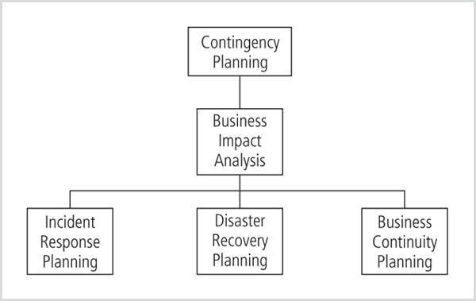
Components of Contingency Planning

Slide 11
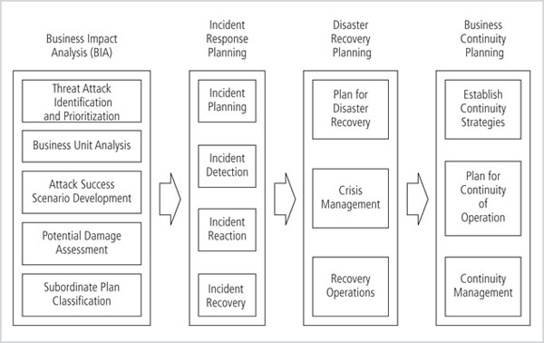
Major Task in CP

Slide 12
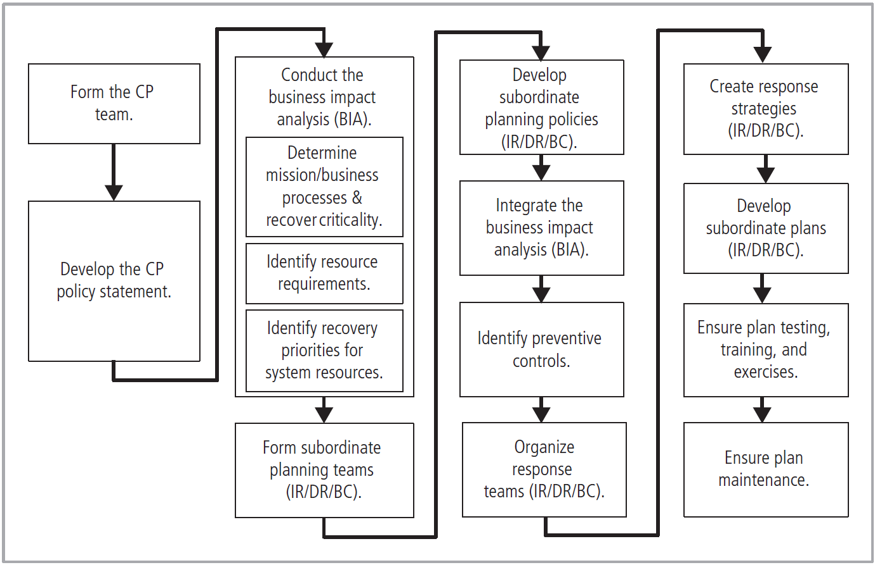
Contingency Planning Life Cycle

Slide 13
Business Impact Analysis (BIA)
Provides the CP team with information about systems and the threats they face
First phase in the CP process
A crucial component of the initial planning stages
Provides detailed scenarios of each potential attack’s impact

Slide 14
Business Impact Analysis (BIA)
BIA is not risk management (which focuses on identifying threats, vulnerabilities, and attacks to determine controls)
BIA assumes controls have been bypassed or are ineffective, and attack was successful

Slide 15
Business Impact Analysis (cont’d.)
The CP team conducts the BIA in the following stages:
Threat attack identification
Business unit analysis
Attack success scenarios
Potential damage assessment
Subordinate plan classification

Slide 16
Business Impact Analysis (cont’d.)
An organization that uses a risk management process will have identified and prioritized threats
Update threat list and add one additional piece of information - the attack profile
An attack profile is a detailed description of activities that occur during an attack
The second major BIA task is the analysis and prioritization of business functions within the organization

Slide 17
Business Impact Analysis (cont’d.)
Create a series of scenarios depicting impact of successful attack on each functional area
Attack profiles should include scenarios depicting typical attack including:
Methodology
Indicators
Broad consequences
Add alternate outcomes
Best case, worst case, and most likely

Slide 18
Business Impact Analysis (cont’d.)
Estimate the cost of the best, worst, and most likely outcomes
By preparing an attack scenario end case
Allows identification of what must be done to recover from each possible case
A related plan must be developed or identified from among existing plans already in place
Each attack scenario end case is categorized as disastrous or not
Attack end cases that are disastrous find members of the organization waiting out the attack, and planning to recover after it is over

Slide 19
Incident Response Plan
A detailed set of processes and procedures that anticipate, detect, and mitigate the impact of an unexpected event that might compromise information resources and assets
Procedures commence when an incident is detected
When a threat becomes a valid attack, it is classified as an information security incident if:
It is directed against information assets
It has a realistic chance of success
It threatens the confidentiality, integrity, or availability of information assets
Incident response is a reactive measure, not a preventative one

Slide 20
Incident Response Plan (cont’d.)
Planners develop and document the procedures that must be performed during the incident
These procedures are grouped and assigned to various roles
The planning committee drafts a set of function-specific procedures

Slide 21
Incident Response Plan (cont’d.)
Planners develop and document the procedures that must be performed immediately after the incident has ceased
Separate functional areas may develop different procedures

Slide 22
Incident Response Plan (cont’d.)
Develop procedures for tasks that must be performed in advance of the incident
Details of data backup schedules
Disaster recovery preparation
Training schedules
Testing plans
Copies of service agreements
Business continuity plans

Slide 23
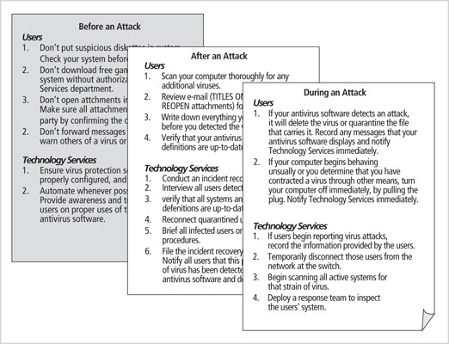
Figure 3-3 Incident response planning

Slide 24
Incident Response Plan (cont’d.)
Planning requires a detailed understanding of the information systems and the threats they face
The IR planning team seeks to develop pre-defined responses that guide users through the steps needed to respond to an incident
Enables rapid reaction without confusion or wasted time and effort

Slide 25
Incident Response Plan (cont’d.)
The IR team consists of professionals capable of handling the information systems and functional areas affected by an incident
Each member of the IR team must know his or her specific role, work in concert with each other, and execute the objectives of the IRP

Slide 26
Incident Response Plan (cont’d.)
Incident classification
Determine whether an event is an actual incident
May be challenging
Uses initial reports from end users, intrusion detection systems, host- and network-based virus detection software, and systems administrators
Careful training allows everyone to relay vital information to the IR team

Slide 27
Incident Response Plan (cont’d.)
Possible indicators
Presence of unfamiliar files
Presence or execution of unknown programs or processes
Unusual consumption of computing resources
Unusual system crashes

Slide 28
Incident Response Plan (cont’d.)
Probable indicators
Activities at unexpected times
Presence of new accounts
Reported attacks
Notification from IDS

Slide 29
Incident Response Plan (cont’d.)
Definite indicators
Use of dormant accounts
Changes to logs
Presence of hacker tools
Notifications by partner or peer
Notification by hacker

Slide 30
Incident Response Plan (cont’d.)
Occurrences of actual incidents
When these occur, the corresponding IR must be immediately activated
Loss of availability
Loss of integrity
Loss of confidentiality
Violation of policy
Violation of law
Once an actual incident has been confirmed and properly classified
IR team moves from the detection phase to the reaction phase
A number of action steps must occur quickly and may occur concurrently
These steps include notification of key personnel, the assignment of tasks, and documentation of the incident

Slide 31
Incident Response Plan (cont’d.)
Alert roster
A document containing contact information on the individuals to be notified in the event of an actual incident either sequentially or hierarchically
The alert message is a scripted description of the incident
Other key personnel must be notified of the incident after the incident has been confirmed, but before media or other external sources learn of it

Slide 32
Incident Response Plan (cont’d.)
Documentation
Begins once an incident has been confirmed and the notification process is underway
Record the who, what, when, where, why and how of each action taken during the incident
Serves as a case study after the fact to determine if the right actions were taken, and if they were effective
Can also prove the organization did everything possible to deter the spread of the incident

Slide 33
Incident Response Plan (cont’d.)
The essential task of IR is to stop the incident or contain its impact
Incident containment strategies focus on two tasks
Stopping the incident
Recovering control of the systems

Slide 34
Incident Response Plan (cont’d.)
Containment strategies
Disconnect the affected communication circuits
Dynamically apply filtering rules to limit certain types of network access
Disabling compromised user accounts
Reconfiguring firewalls to block the problem traffic
Temporarily disabling the compromised process or service
Taking down the conduit application or server (e.g. e-mail server)
Stopping all computers and network devices

Slide 35
Incident Response Plan (cont’d.)
An incident may increase in scope or severity to the point that the IRP cannot adequately contain the incident
Each organization will have to determine, during the business impact analysis, the point at which the incident becomes a disaster
The organization must also document when to involve outside response

Slide 36
Incident Response Plan (cont’d.)
Once contained and system control regained, incident recovery can begin
The IR team must assess the full extent of the damage in order to determine what must be done to restore the systems
Incident damage assessment
Determination of the scope of the breach of confidentiality, integrity, and availability of information and information assets
Those who document the damage must be trained to collect and preserve evidence, in case the incident is part of a crime or results in a civil action

Slide 37
Incident Response Plan (cont’d.)
Recovery process
Identify the vulnerabilities that allowed the incident to occur and spread and resolve them
Address the safeguards that failed to stop or limit the incident, or were missing from the system in the first place and install, replace or upgrade them
Evaluate monitoring capabilities (if present) to improve detection and reporting methods, or install new monitoring capabilities
Restore the data from backups as needed
Restore the services and processes in use where compromised (and interrupted) services and processes must be examined, cleaned, and then restored
Continuously monitor the system
Restore the confidence of the members of the organization’s communities of interest

Slide 38
Incident Response Plan (cont’d.)
Before returning to routine duties, the IR team must conduct an after-action review (AAR)
A detailed examination of the events that occurred
All team members review their actions during the incident and identify areas where the IR plan worked, didn’t work, or should improve
When an incident violates civil or criminal law, it is the organization’s responsibility to notify the proper authorities
Selecting the appropriate law enforcement agency depends on the type of crime committed: Federal, State, or local
Involving law enforcement has both advantages and disadvantages
They are usually much better equipped at processing evidence, obtaining statements from witnesses, and building legal cases
However, involvement can result in loss of control of the chain of events following an incident

Slide 39
Disaster Recovery Plan
The preparation for and recovery from a disaster, whether natural or man made
In general, an incident is a disaster when:
The organization is unable to contain or control the impact of an incident, or
The level of damage or destruction from an incident is so severe the organization is unable to quickly recover
The key role of a DRP is defining how to reestablish operations at the location where the organization is usually located

Slide 40
Disaster Recovery Plan (cont’d.)
A DRP can classify disasters in a number of ways
The most common method is to separate natural disasters from man-made disasters
Another way of classifying disasters is by speed of development
Rapid onset disasters
Slow onset disasters

Slide 41
Disaster Recovery Plan (cont’d.)
Scenario development and impact analysis
Used to categorize the level of threat of each potential disaster
DRP must be tested regularly
Key points in the DRP
Clear delegation of roles and responsibilities
Execution of the alert roster and notification of key personnel
Clear establishment of priorities
Documentation of the disaster
Action steps to mitigate the impact
Alternative implementations for the various systems components

Slide 42
Disaster Recovery Plan (cont’d.)
Actual events often outstrip even the best of plans
To be prepared, DRP should be flexible
If physical facilities are intact, begin restoration
If organization’s facilities are unusable, take alternative actions
When disaster threatens the organization at the primary site, DRP becomes BCP

Slide 43
Business Continuity Plan
Ensures critical business functions can continue in a disaster
Managed by CEO of the organization
Activated and executed concurrently with the DRP when needed
While BCP reestablishes critical functions at alternate site, DRP focuses on reestablishment at the primary site

Slide 44
Business Continuity Plan (cont’d.)
Relies on identification of critical business functions and the resources to support them
Continuity strategies
Exclusive-use options: hot, warm and cold sites
Shared-use options: timeshare, service bureaus, mutual agreements
Determining factor is usually cost

Slide 45
Business Continuity Plan (cont’d.)
Hot Sites
Fully configured computer facility with all services
Warm Sites
Like hot site, but software applications not kept fully prepared
Cold Sites
Only rudimentary services and facilities kept in readiness

Slide 46
Business Continuity Plan (cont’d.)
Timeshares
Like an exclusive use site but leased
Service bureaus
Agency that provides physical facilities
Mutual agreements
Contract between two organizations to assist
Specialized alternatives
Rolling mobile site
Externally stored resources

Slide 47
Business Continuity Plan (cont’d.)
To get any BCP site running quickly organization must be able to recover data
Options include:
Electronic vaulting
Bulk batch-transfer of data to an off-site facility
Remote journaling
Transfer of live transactions to an off-site facility
Database shadowing
Storage of duplicate online transaction data

Slide 48
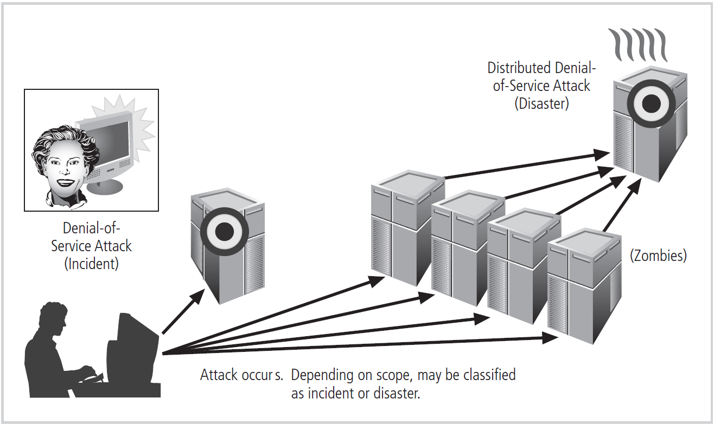
Timing and Sequence of CP Elements

Slide 49
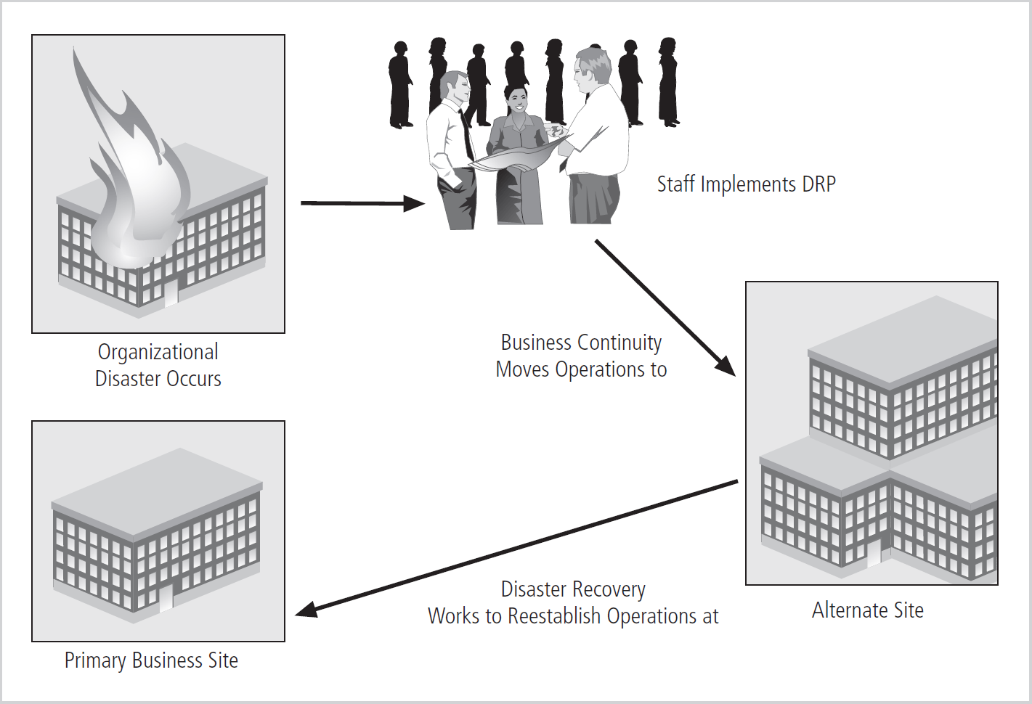
Timing and Sequence of CP Elements (cont’d.)

Slide 50
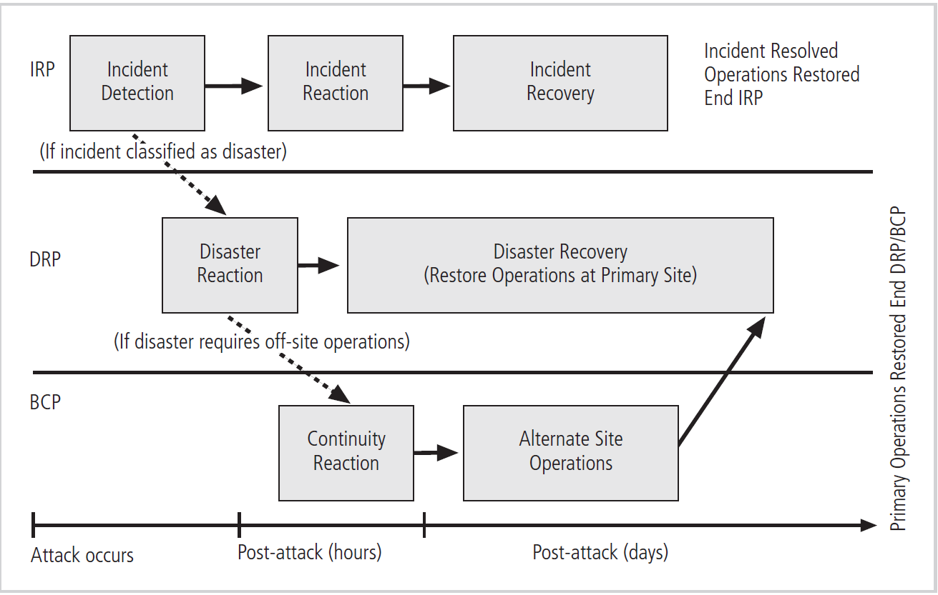
Timing and Sequence of CP Elements (cont’d.)

Slide 51
Testing Contingency Plans
Problems are identified during testing
Improvements can be made, resulting in a reliable plan
Contingency plan testing strategies
Desk check
Structured walkthrough
Simulation
Parallel testing
Full interruption testing

Slide 52
Contingency Planning: Final Thoughts
Iteration results in improvement
A formal implementation of this methodology is a process known as continuous process improvement (CPI)
Each time the plan is rehearsed it should be improved
Constant evaluation and improvement lead to an improved outcome

Slide 53
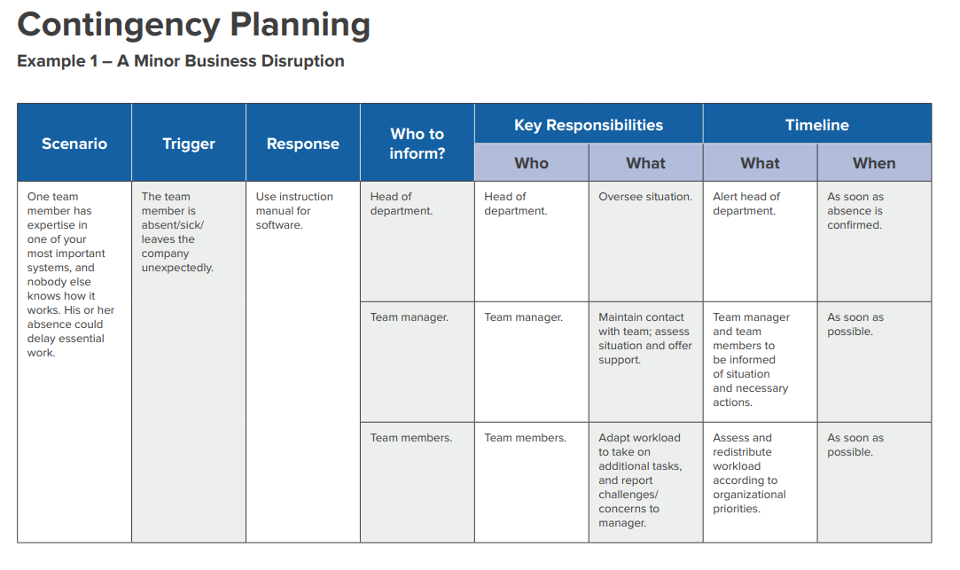
Contingency Planning: Final Thoughts

Slide 54
